Slide 1
Global Business Environment
Unit 6

Slide 2
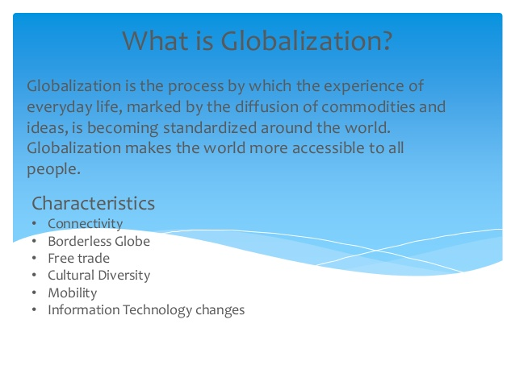

Slide 3


Slide 4


Slide 5
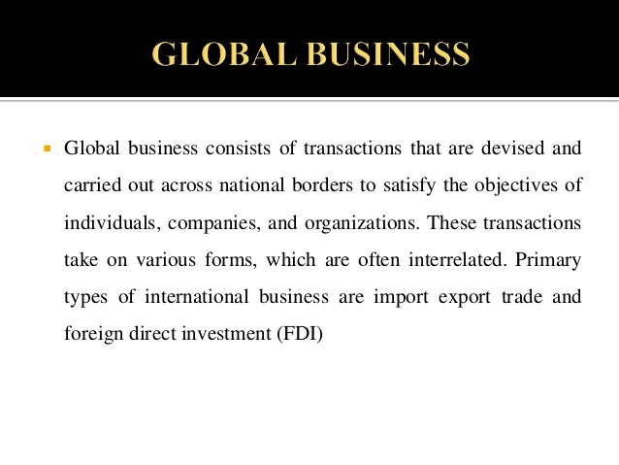

Slide 6


Slide 7
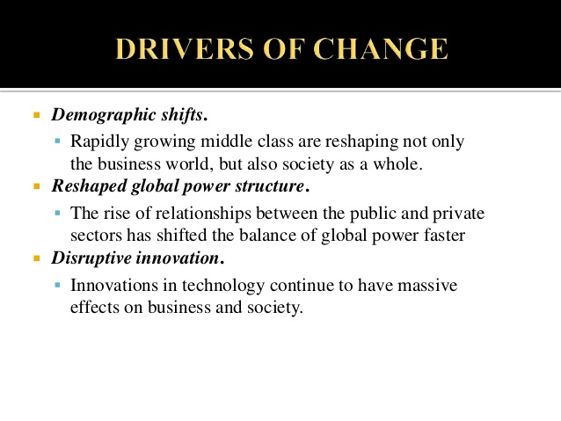

Slide 8


Slide 9
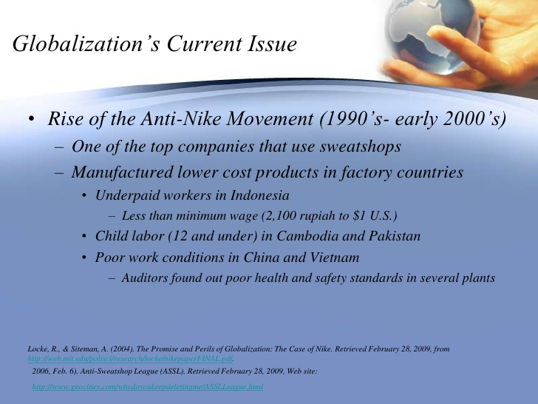

Slide 10


Slide 11


Slide 12
Reginal grouping of nation

Slide 13
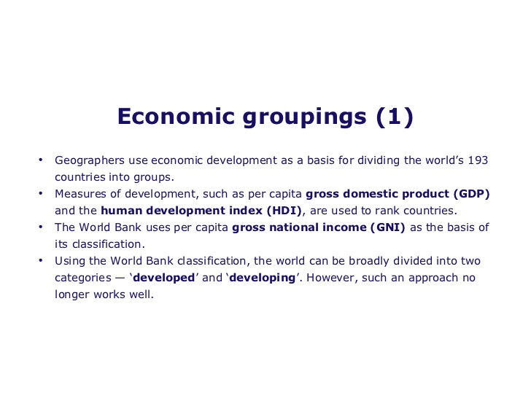

Slide 14
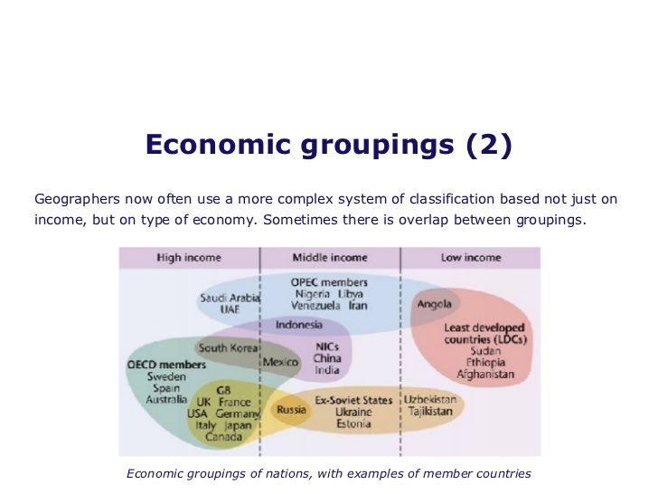

Slide 15
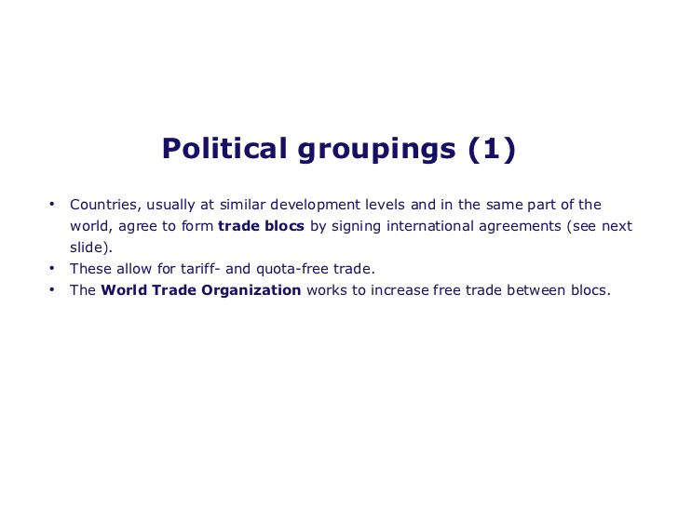

Slide 16
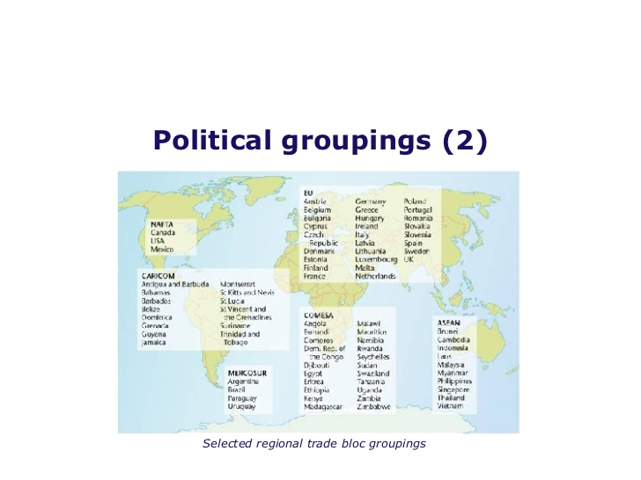

Slide 17
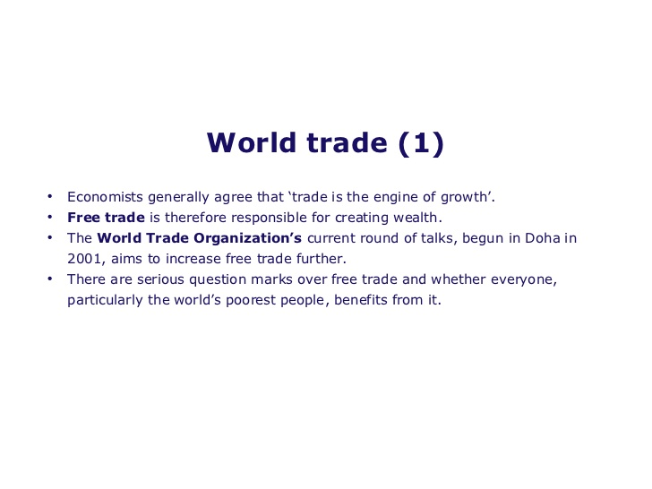

Slide 18
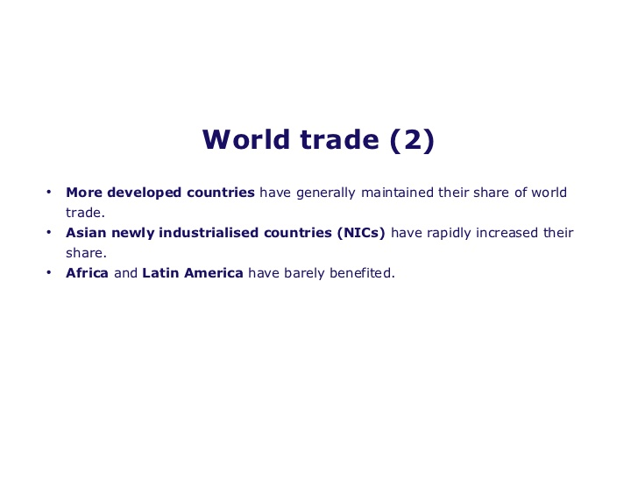

Slide 19
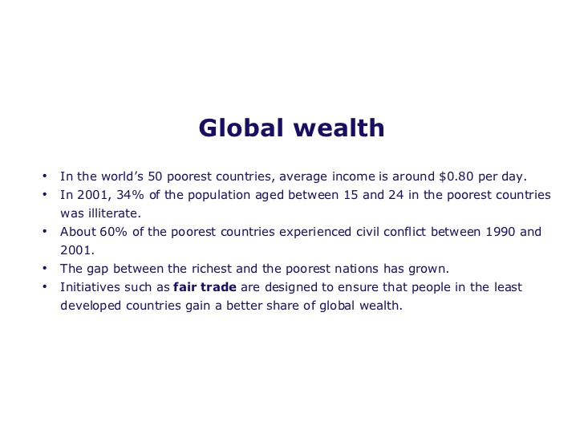

Slide 20
Regional trade agreements (RTAs) are defined as reciprocal trade agreements between two or more partners. They include free trade agreements and customs unions.

Slide 21
SAARC AND SOUTH ASIAN TRADE
SAARC established in 1985.Member countries: Afghanistan, Bangladesh, Bhutan, India, Maldives, Nepal, Pakistan, Sri Lanka.

Slide 22
Core objectives:
To promote and strengthen collective self-reliance among the countries of South Asia
To contribute to develop mutual trust, understanding and appreciation of one another’s problem
To promote active collaboration and mutual assistance in the economic, social, cultural, technical and scientific fields
To strengthen cooperation with other developing countries
To strengthen cooperation among themselves in international forums on matters of common interest
To cooperate with international and regional organizations with similar aims and purposes.

Slide 23
Progress so far
South Asian Free Trade Agreement (SAFTA)
Convention on Fighting Terrorism
SAARC Developmental Goals (SDGs)
SAARC Development Fund
SAARC Food Bank
Observer states include US, Japan, China.
Regional agreement on ‘Trade in Services’
Institutions need to address issues of empowerment, and formulate appropriate implementation and monitoring strategies

Slide 24
South Asian Trade
Intraregional trade is less than 5% of total trade in South Asia (World Bank, 2009)
Presence of Tariff and non-tariff barriers
Substantial potential for trade due to high population density and geographical proximity.
Trade essential to achieve investment, generate employment and mitigate poverty in the region.

Slide 25
South Asian Trade
Intraregional trade is less than 5% of total trade in South Asia (World Bank, 2009)
Presence of Tariff and non-tariff barriers
Substantial potential for trade due to high population density and geographical proximity.
Trade essential to achieve investment, generate employment and mitigate poverty in the region.

Slide 26
SAFTA- Key Features…
South Asian Free Trade Agreement (SAFTA) signed at the 12th SAARC Summit in Islamabad, Pakistan.
Build on SAARC Preferential Trade Agreement (SAPTA)
Enhanced scope of regional trade dialogue to include competition, trade and transportation, harmonization of legislation, banking procedures, forex regulations and immigration processes.
Trade Liberalization Programme (TLP): reduce tariffs and eliminate restrictions on quantity of goods traded.
Trade not only in goods, but in services and investment too!

Slide 27
SAFTA – Key features
Non-LDC member states required to reduce existing tariffs to 20 percent within 2 years and then to 0–5 percent in the next 5 years.
LDC member countries required to reduce existing tariffs to 30 percent in 2 years and then to 0–5 percent in the next 8 years.
Rules of Origin: ensure domestic value addition.
Encouraged negotiations for setting ceiling on negative list by each member country.

Slide 28
Objectives of SAFTA
Promoting and enhancing mutual trade and economic cooperation by eliminating barriers in trade
Promoting conditions of fair competition in the free trade area,
Ensuring equitable benefits to all

Slide 29
Establishing a framework for further regional cooperation to expand the mutual benefits of the agreement.
creating effective mechanism for the implementation and application of this Agreement, for its joint administration and for the resolution of disputes;

Slide 30
BIMSTEC
Bay of Bengal Initiative for Multispectral Technical and Economic Cooperation (BIMSTEC)
an international organization involving a group of countries in South Asia and South East Asia
The member countries of this group are:
Bangladesh, India, Myanmar, Sri Lanka, Thailand, Bhutan and Nepal.

Slide 31
BIMSTEC has thirteen priority sectors cover all areas of cooperation. Six priority sectors of cooperation were identified at the 2nd Ministerial Meeting in Dhaka on 19 November 1998. They include the followings:
Trade and Investment, led by Bangladesh
Transport and Communication, led by India
Energy, led by Myanmar
Tourism, led by India
Technology, led by Sri Lanka
Fisheries, led by Thailand

Slide 32
Agriculture, led by Myanmar
Public Health, led by Thailand
Poverty Alleviation, led by Nepal
Counter-Terrorism and Transnational Crime, led by India
Environment and Natural Disaster Management, led by India
Culture, led by Bhutan
People to People contact, led by Thailand

Slide 33
The aims and purposes of BIMSTEC
To create an enabling environment for rapid economic development;
Accelerate social progress in the sub-region, promote active collaboration and mutual assistance on matters of common interest;
Provide assistance to each other in the form of training and research facilities;

Slide 34
Membership Criteria
Eligibility: Countries seeking membership should satisfy the conditions of territorial contiguity to, or direct opening into, or primary dependence on the Bay of Bengal for trade and transportation purposes
Procedure: All applications should be submitted in writing to the Chairman of BIMSTEC. The decision on admitting new members will be taken on the basis of consensus by all the BIMSTEC members
Institutional Structure and Arrangements
The BIMST-EC Declaration provides for the following institutional mechanisms: Annual Ministerial Meetings, which shall be hosted by the Member States on the basis of alphabetical rotation; Senior Officials Committee, which shall meet on a regular basis as and when required;

Slide 35
A Working Group, under the chairmanship of Thailand and having as its members the accredited Ambassadors to Thailand, or their representatives, of the other Member States, to carry on the work in between Annual Ministerial Meetings; And Specialized task forces and other mechanisms as maybe deemed necessary by the senior Officials to be coordinated by Member States as appropriate

Slide 36
Economic significance
The BIMSTEC agreement aimed to create a free trade zone where tariffs would be brought down to zero by 2012
BIMSTEC would facilitate improvement in the trade at institutional and people level, most of the member countries are suffering from the menace of corruption, so the trade links at institutional and private level be positively resulted in enhanced trade links
The members of BIMSTEC realize well that to benefit mutually in emerging globalization, they are to support and cooperate with each other whole heartedly
it is important that all the countries should strive not only for the economic Cooperation, but also for the cultural and social links so that more closure and beneficial ties could take place

Slide 37
AFTA and BIMSTEC Comparison
BIMSTEC-FTA is a wide scope agreement covering trade in service, investment and tourism which are not included by SAFTA
BIMSTEC aimed to serve as a bridge between the five SAARC countries and two ASEAN countries whereas SAFTA provisions called for the gradual reduction of tariffs, customs duties, and other trade barriers between the eight members of South Asia
In BIMSTEC Tariff reduction/elimination will be divided into 2 tracks : Fast Track and Normal Track. Other than that, some of the products will be listed in the Negative List, to which no tariff reduction will be granted at this point whereas in SAFTA no such tracks are divided for tariff reduction

Slide 38
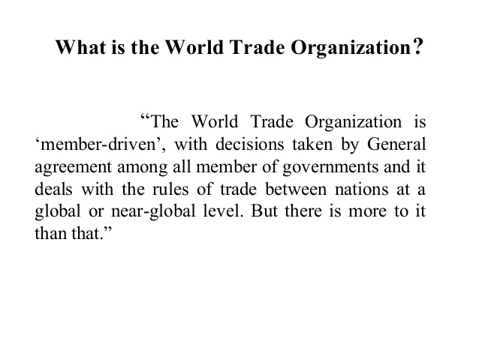

Slide 39
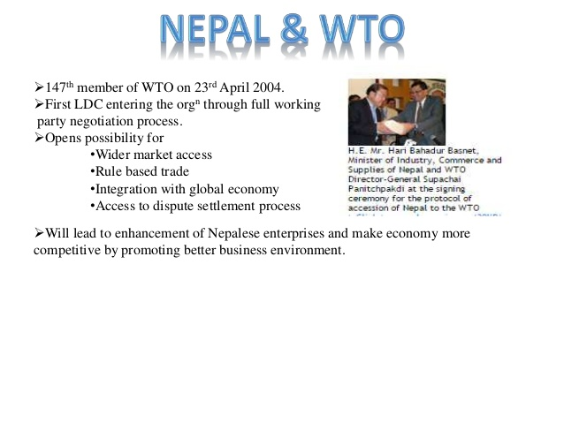

Slide 40
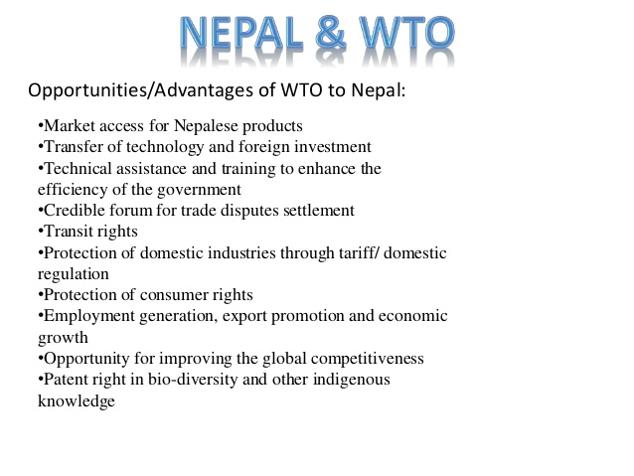

Slide 41
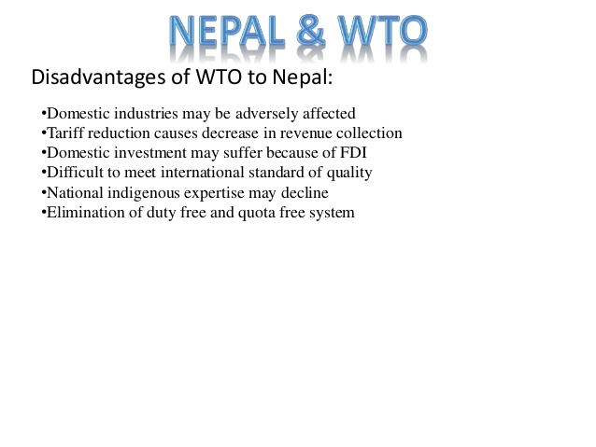

Slide 42
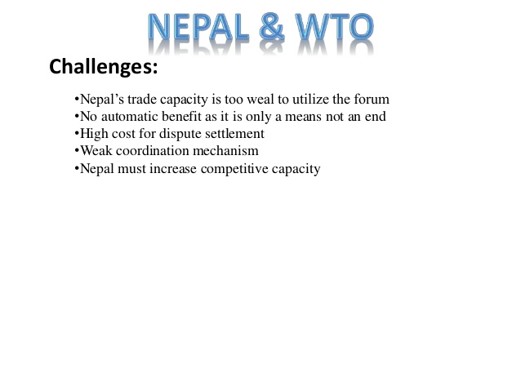

Slide 43

ALL THE BEST.

